Slide 1
Automated Attendance System
Course: CSE 4408 – System Analysis and Design Lab

Slide 2
Team Composition
Member Name | Member ID
Mohammad Ishrak Abedin | 160041051
Shakleen Ishfar | 160041029
Anika Tasnim Preoty | 160041044

Slide 3
Introduction
This project is about building an automated attendance system that is fast, reliable, easy to implement and less sophisticated hardware oriented than the systems that are currently in use at other places. Our system aims at solving the problems of current analogue attendance system through a way that is convenient for both teachers and students. Through the implementation of regular day hardware that everyone uses, like mobile phones and computers, we wish to automate the attendance system in a simple but effective manner.

Slide 4
What will our system do?
Our system comprises of two major parts, one for the students, the other for the teacher. In short, every class, using the system, the teacher would generate a QR code that will be shown through projector. The students will log into SIS (Student Information System) and scan the QR that would give them present. The teacher can review and modify the attendance and also get all related reports connected with attendance like percentage, whether any student is defaulter or not and many others. A limited time window and secured log in will provide security to the system.

Slide 5
Problems in Current System
Manual
Time consuming
Prone to error
Prone to proxy
Difficult to manage and store
Requirement of manual calculations for attendance related information

Slide 6
Proposed Solution
An automated system
Quick attendance taking
Accurate
Secured
Auto management and storage
Automated and real time calculation of attendance information and report generation

Slide 7
Diagrams and Work Flow
Data flow, class and sequence diagrams

Slide 8
Data Flow Diagrams

Slide 9
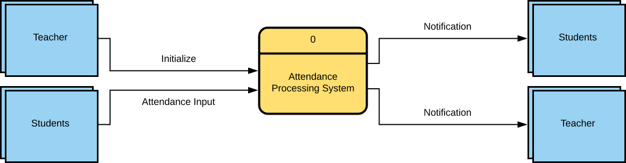
Context Diagram

Slide 10
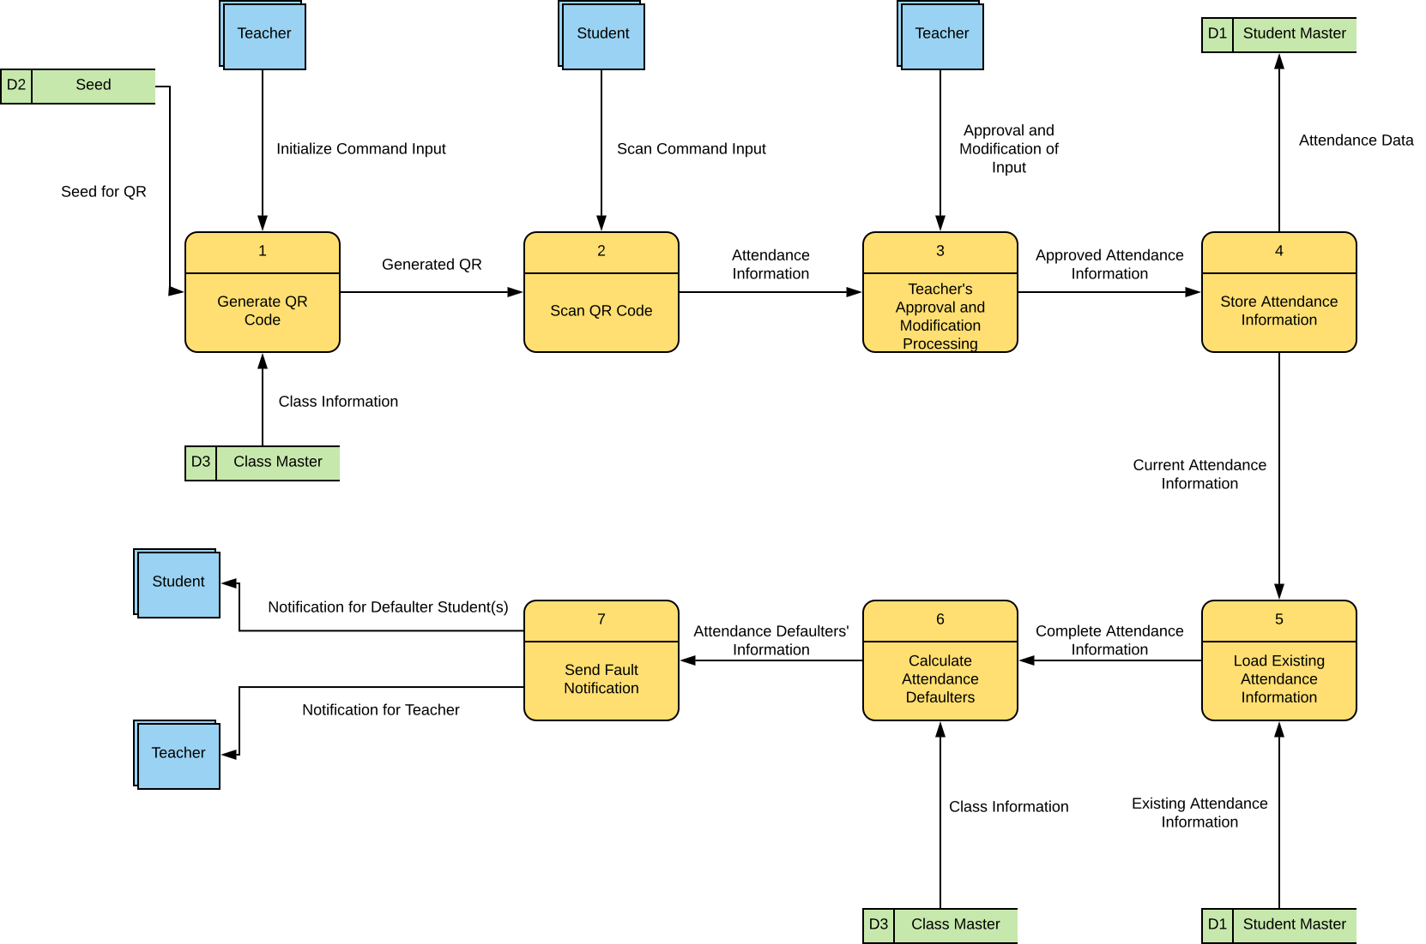
Zero Diagram

Slide 11
Class Diagram

Slide 12
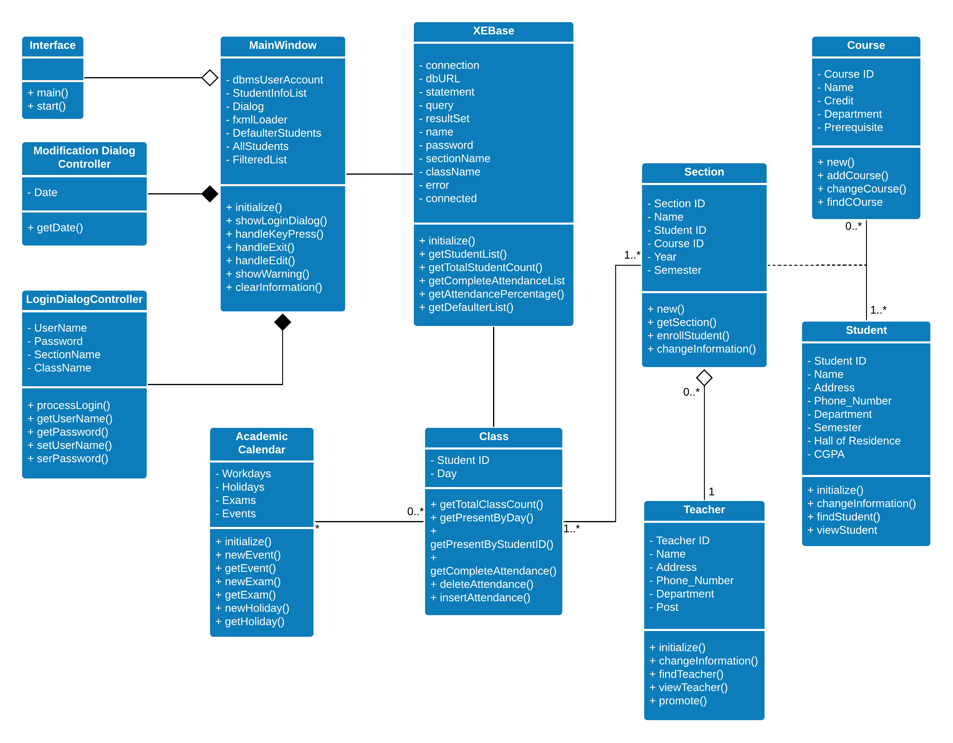
Attendance System Class Diagram

Slide 13
Sequence Diagram

Slide 14
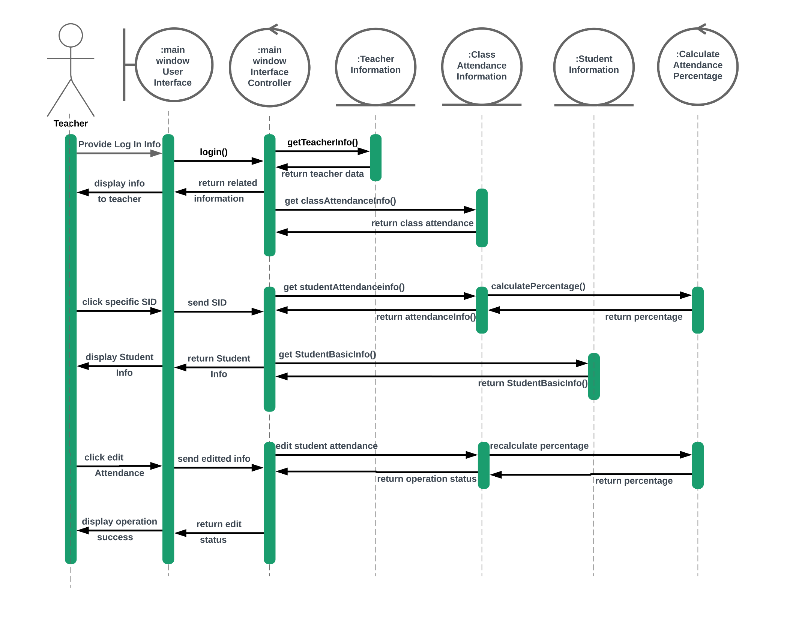
Attendance System Sequence Diagram

Slide 15
Prototype Presentation

Slide 16
Conclusion and Future Works
In this project, we attempted to introduce a cost efficient but effective attendance system that would solve the current issues in the attendance system of IUT. Due to the lacking of time and various other works, we only managed to develop prototype for one part of the system. In the future, we wish to complete the whole system and put it for a test run. At the same time, in the big picture, we wanted to develop a complete app system for IUT that would let students do all of their various activities while managing daily and academic life. So as a continuation of this project, we wish to achieve such a system in the future.

Slide 17
Thank you all!!!
Any Questions?

